Slide 1
K-means Clustering Algorithm

Slide 2
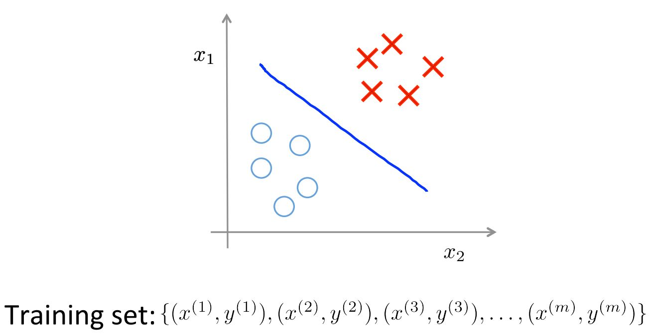
Supervised Learning

Slide 3
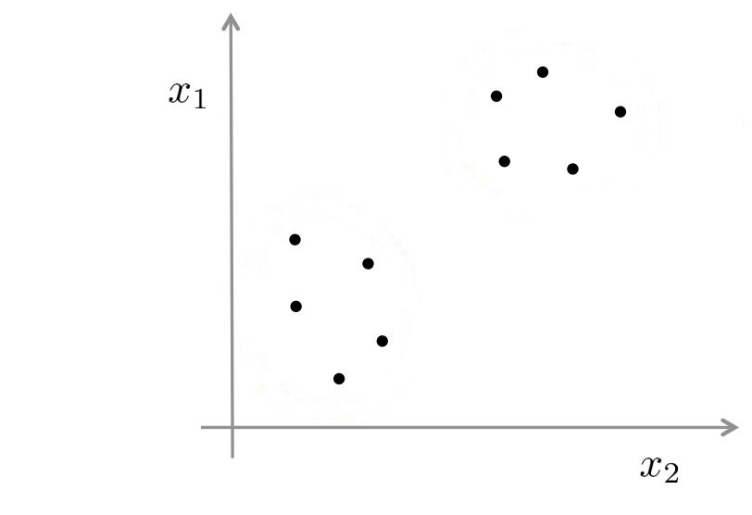
Unsupervised Learning

Slide 4
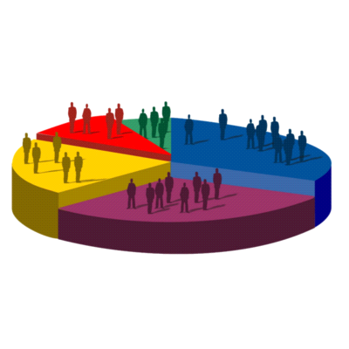
Application on Clustering
Market Segmentation

Slide 5
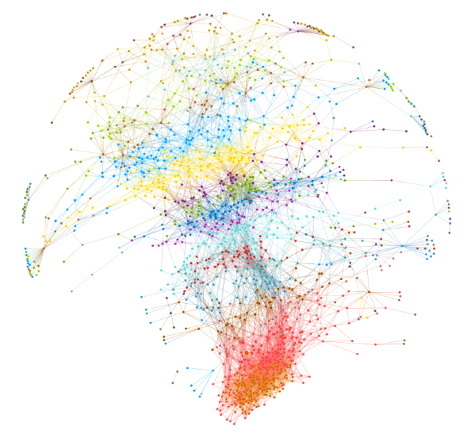
Application on Clustering (Cont’d)
Social Network Analysis

Slide 6
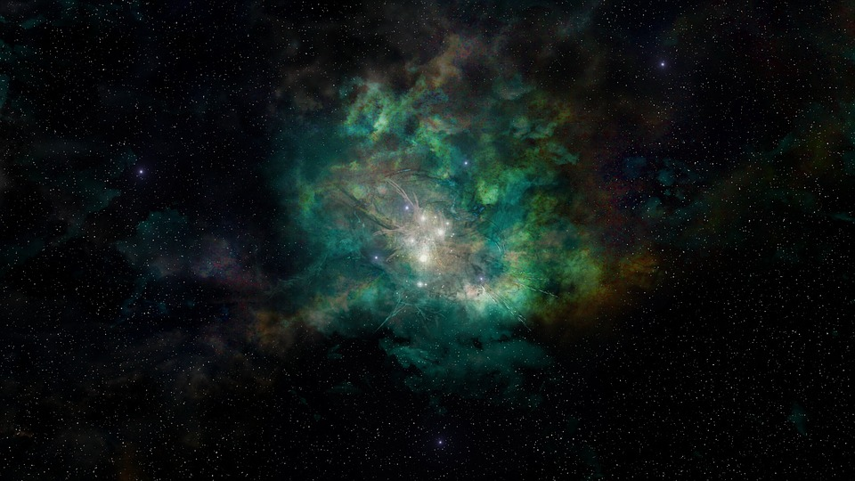
Application on Clustering (Cont’d)
Astronomical Data Analysis

Slide 7
K-means Algorithm
What does K represents in this clustering algorithm?
Answer: The number of cluster we want to create.

Slide 8
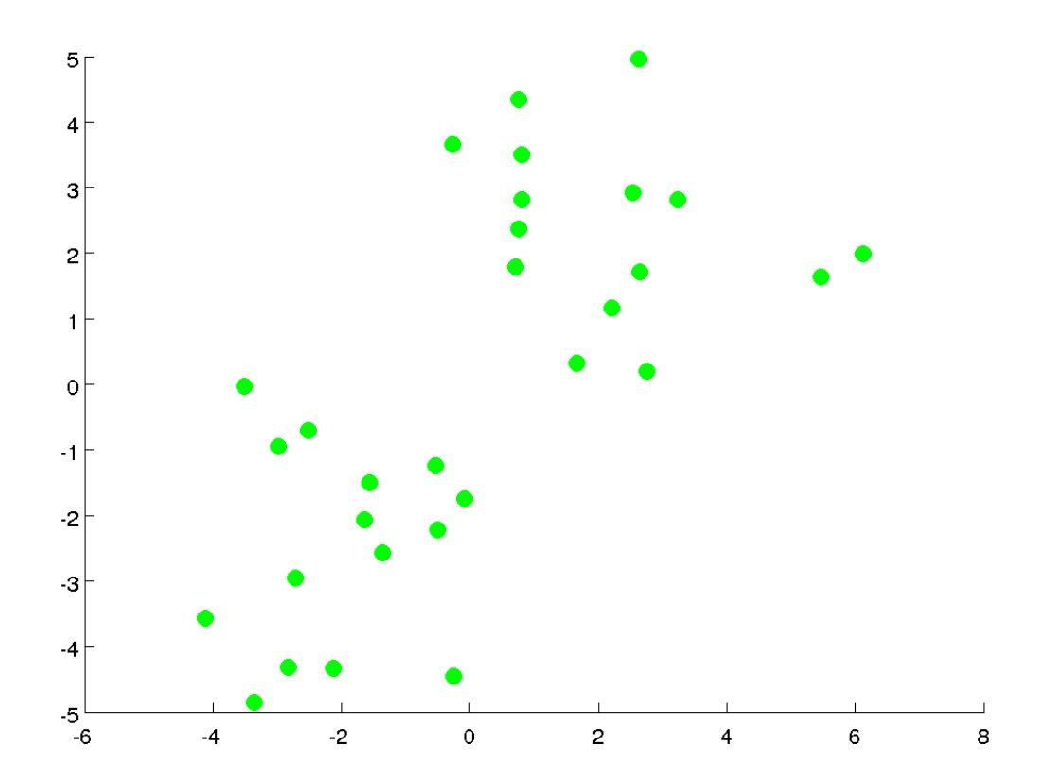
K-means Algorithm (Cont’d)

Slide 9
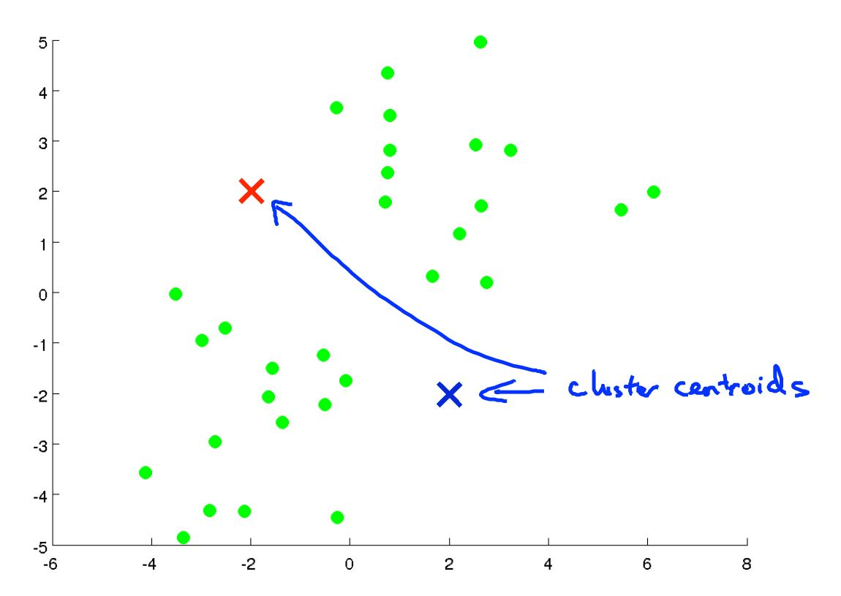
K-means Algorithm (Cont’d)

Slide 10
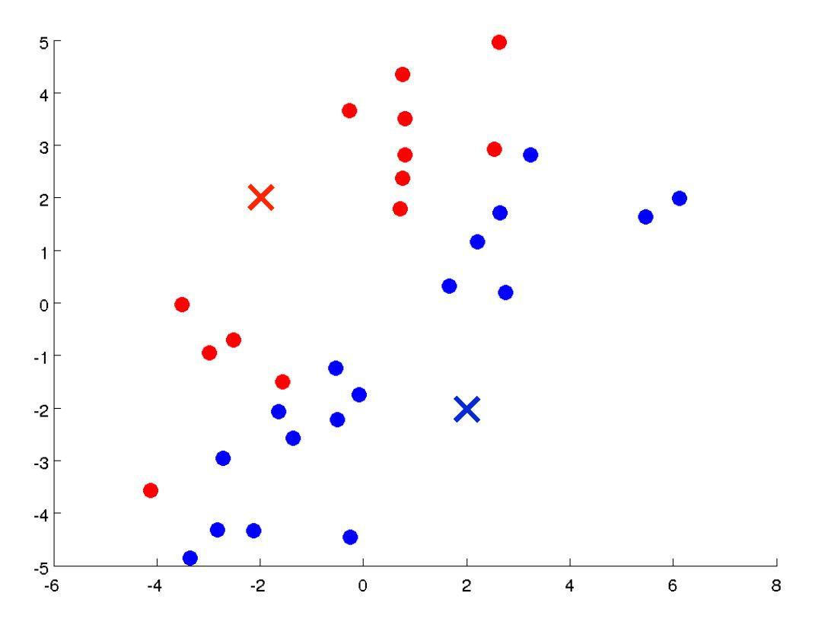
K-means Algorithm (Cont’d)

Slide 11
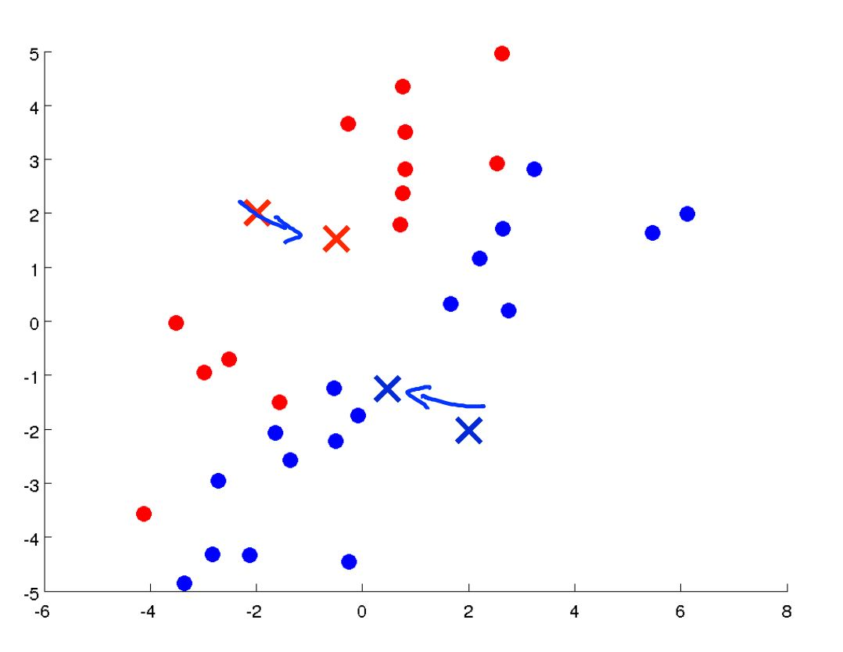
K-means Algorithm (Cont’d)

Slide 12
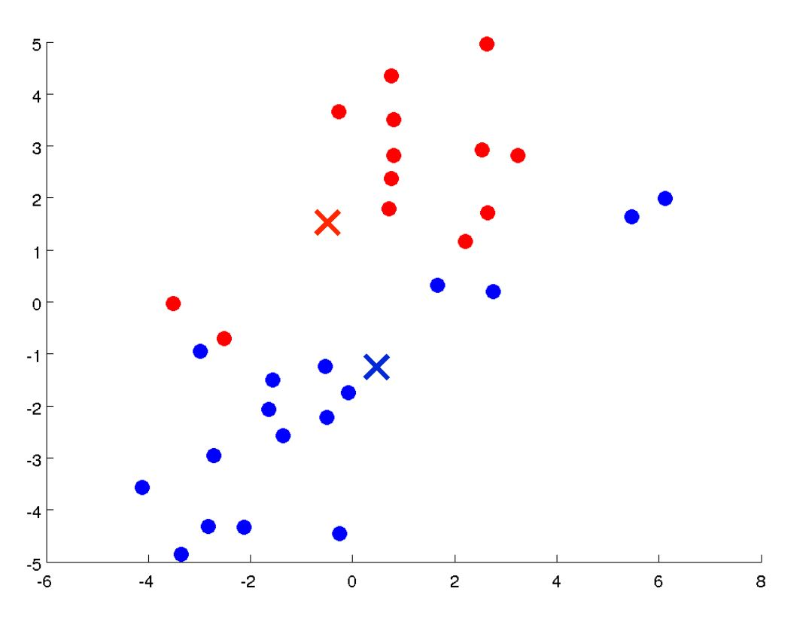
K-means Algorithm (Cont’d)

Slide 13
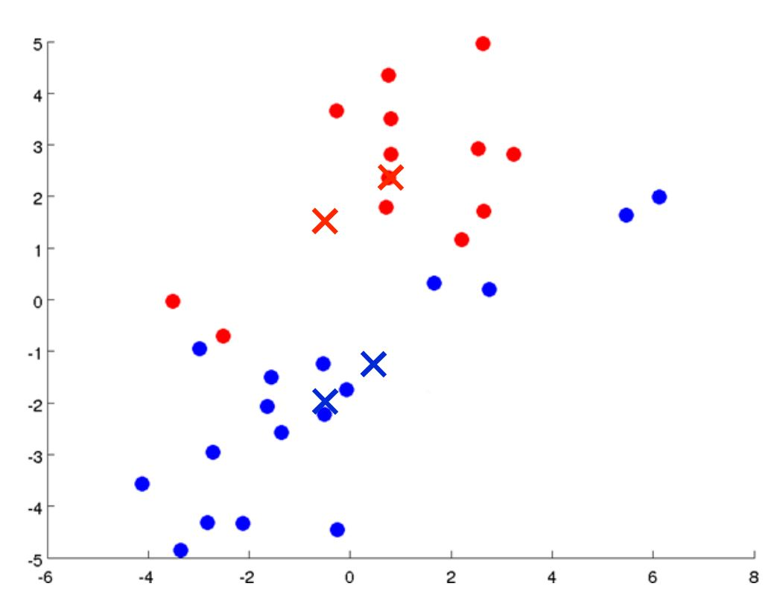
K-means Algorithm (Cont’d)

Slide 14
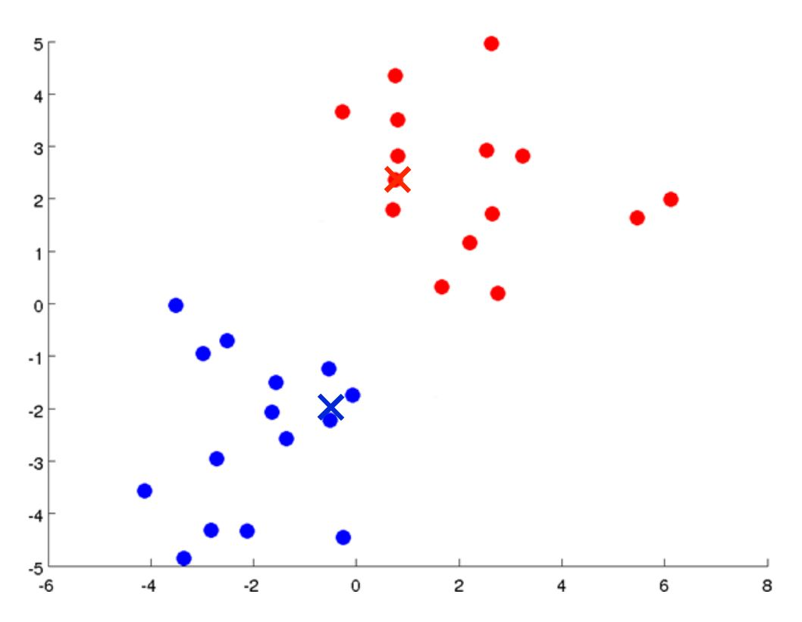
K-means Algorithm (Cont’d)

Slide 15
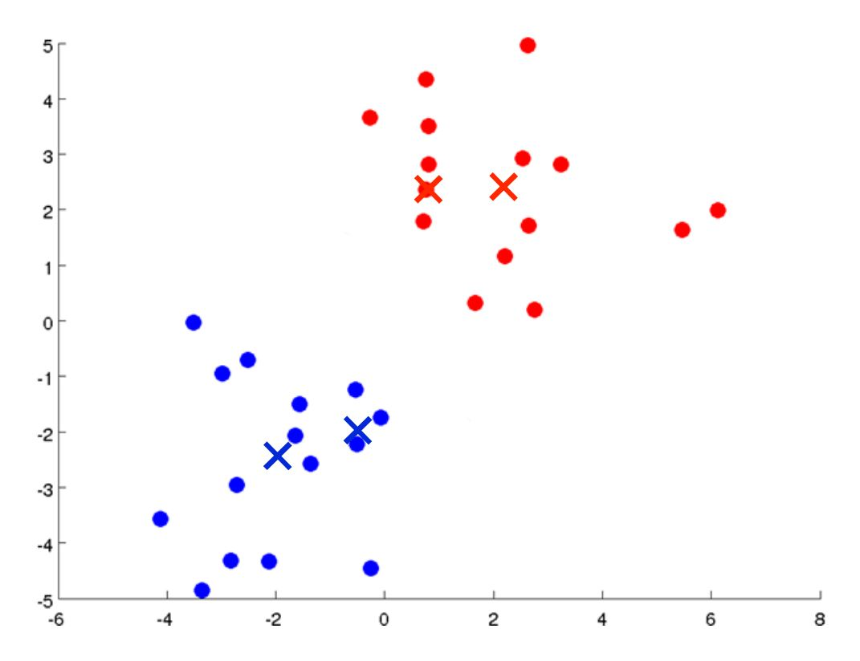
K-means Algorithm (Cont’d)

Slide 16
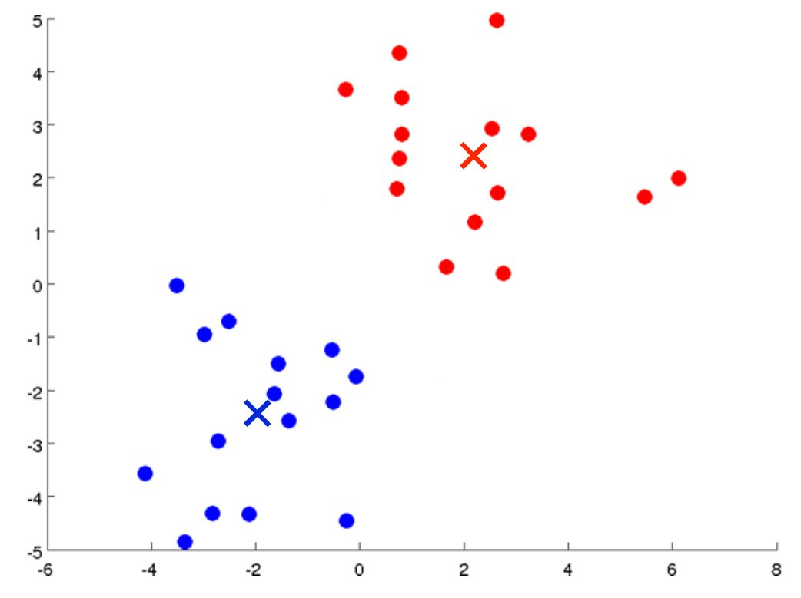
K-means Algorithm (Cont’d)

Slide 17
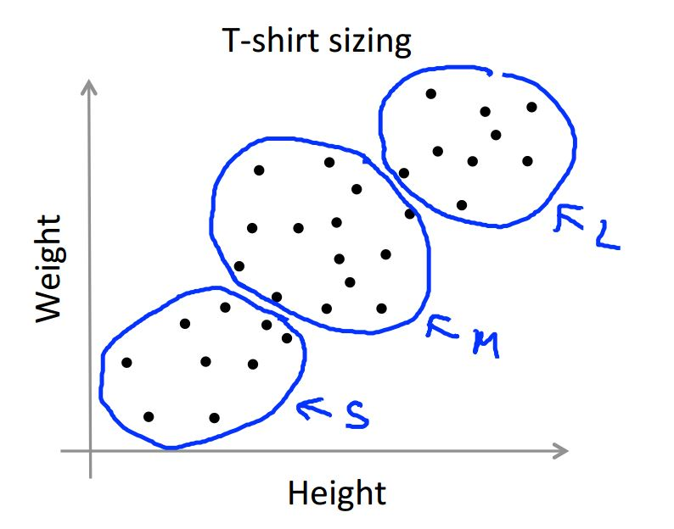
A real life application of K-means Clustering

Slide 18
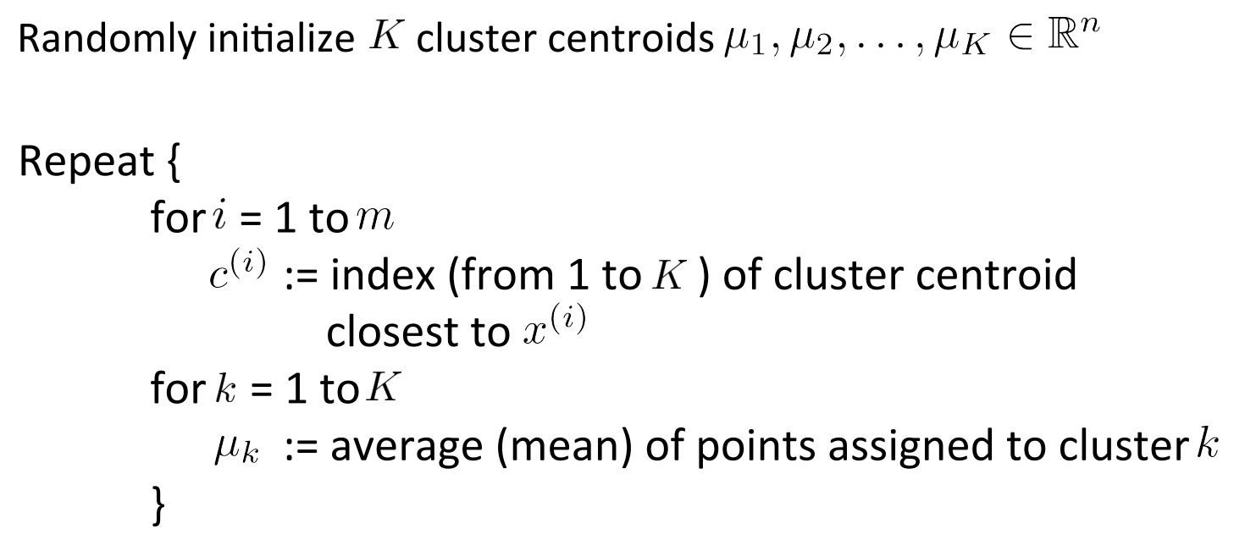
K-means Clustering Algorithm in general

Slide 19
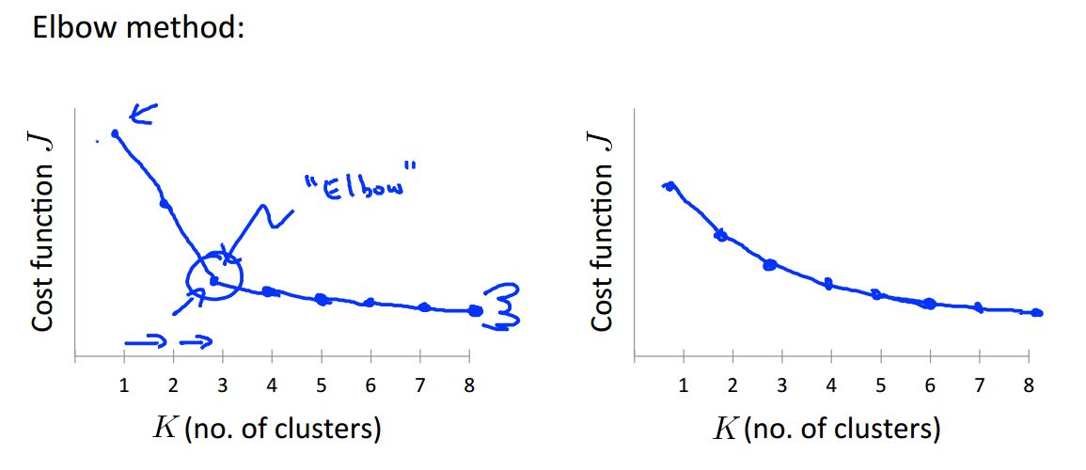
How to choose the value of K?

Slide 20
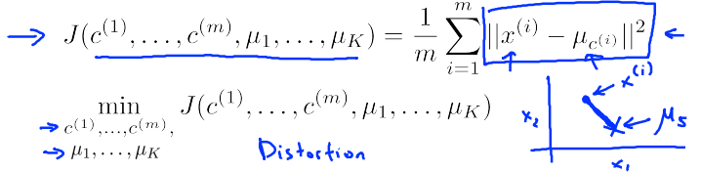
Value of Cost Function

Slide 21
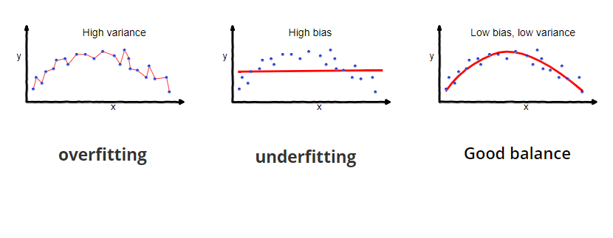
Overfitting and Underfitting

Slide 22
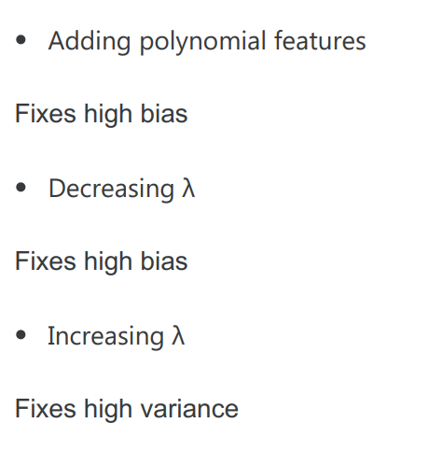
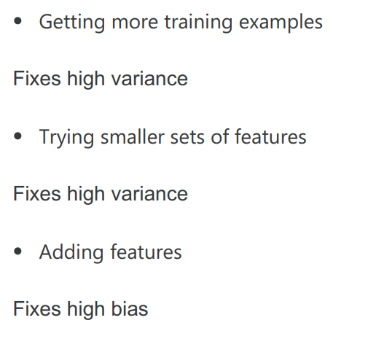
How to Overcome Overfitting and Underfitting

Slide 23

Thank you for your many lessons Lord Baelish. I will never forget them.

Slide 24
Thanks for letting me finish the class real quick!

Slide 25
Or did you?

Slide 26
Any Question/Suggestion?

